Slide 1
Content
Fundamentals of machine learning
Simplest math example
Model measurement and deployment
Transformers for Large Language Models
Tokenization and embedding
Transformer and decoder
Computer vision
Convolution computation
Image classification example

Slide 2
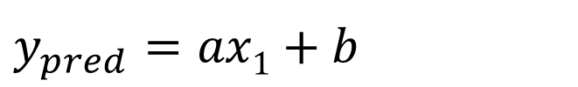
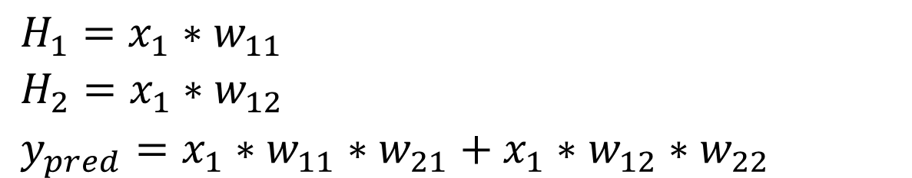
y
$y_{pred}$ $=ax1+b$
H₁
30
w₁₁
w₂₁
x₁
y
20
w₂₂
w₁₂
H₂
10
0
1
2
5
x
$H_{1}=x_{1}∗w_{11}$
$H_{2}=x_{1}∗w_{12}$
$y_{pred}=x_{1}∗w_{11}∗w_{21}+x_{1}∗w_{12}∗w_{22}$
x | y
1 | 10
2 | 20
5 | 30

Slide 3
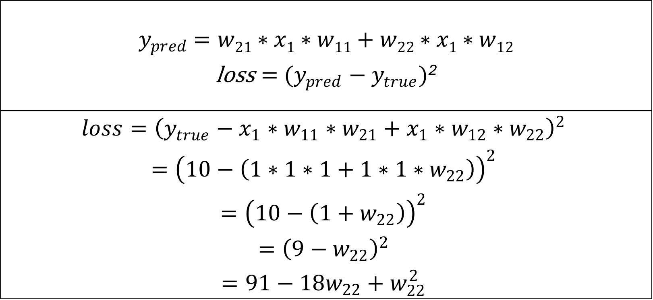
$y_{pred}$ $=w21∗x1∗w11+w22∗x1∗w12$ $\text{loss}={ (y_{pred}−y}_{true})$²
$$loss={\left(y_{true}−x_{1}∗w_{11}∗w_{21}+x_{1}∗w_{12}∗w_{22}\right)}^{2}$$ $$={\left(10−\left(1∗1∗1+1∗1∗w_{22}\right)\right)}^{2}$$ $$={\left(10−\left({1+w}_{22}\right)\right)}^{2}$$ $$={\left(9−w_{22}\right)}^{2}$$ $$=91−18w_{22}+w_{22}^{2}$$
x | y
1 | 10
2 | 20
5 | 30

Slide 4
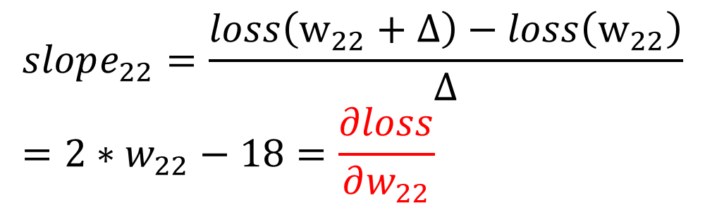
H₁
Loss
w₁₁
w₂₁
x₁
y
w₂₂
w₁₂
H₂
Slope: -
Slope: +
0
9
w₂₂
$$loss=91−18w_{22}+w_{22}^{2}$$
x | y
1 | 10
2 | 20
5 | 30
$$slope_{22}=\frac{loss\left(w_{22}+Δ\right)−loss\left(w_{22}\right)}{Δ}=2∗w_{22}−18=\frac{∂loss}{∂w_{22}}$$

Slide 5
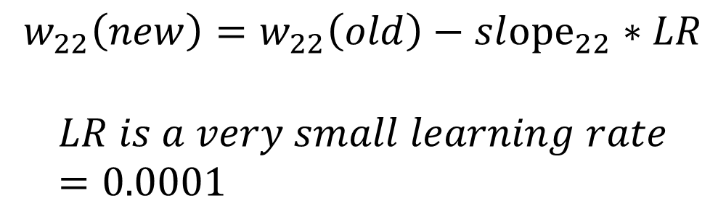
H₁
Loss
w₁₁
w₂₁
x₁
y
w₂₂
w₁₂
H₂
Slope: -
Slope: +
0
9
w₂₂
x | y
1 | 10
2 | 20
5 | 30
$$w_{22}\left(new\right)=w_{22}\left(old\right)−sl{ope}_{22}∗LR$$
$$LR is a very small learning rate=0.0001$$

Slide 6
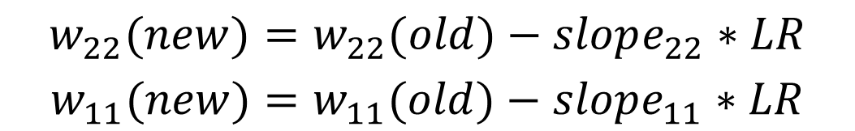
H₁
Loss
w₁₁
w₂₁
x₁
y
w₂₂
w₁₂
H₂
0
w₂₂
w₁₁
$$w_{22}(new)=w_{22}(old)−slope_{22}∗LR$$
$$w_{11}(new)=w_{11}(old)−slope_{11}∗LR$$
x | y
1 | 10
2 | 20
5 | 30

Slide 7

$$w_{22}(new)=w_{22}(old)−slope_{22}∗LR$$
$$w_{11}(new)=w_{11}(old)−slope_{11}∗LR$$
$$w_{12}(new)=w_{12}(old)−slope_{12}∗LR$$
$$w_{21}(new)=w_{21}(old)−slope_{21}∗LR$$
Loss
H₁
w₁₁
w₂₁
x₁
y
w₂₂
w₁₂
H₂
0
w₂₂
w₁₁

Slide 8
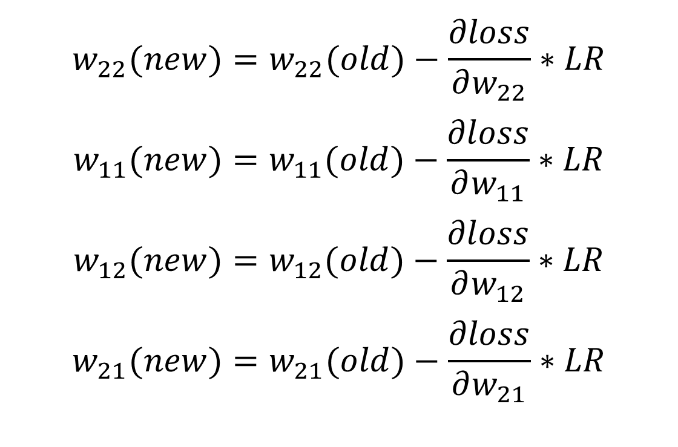
H₁
w₁₁
w₂₁
x₁
y
w₂₂
w₁₂
H₂
$$w_{22}(new)=w_{22}(old)−\frac{∂loss}{∂w_{22}}∗LR$$
$$w_{11}(new)=w_{11}(old)−\frac{∂loss}{∂w_{11}}∗LR$$
$$w_{12}(new)=w_{12}(old)−\frac{∂loss}{∂w_{12}}∗LR$$
$$w_{21}(new)=w_{21}(old)−\frac{∂loss}{∂w_{21}}∗LR$$

Slide 9
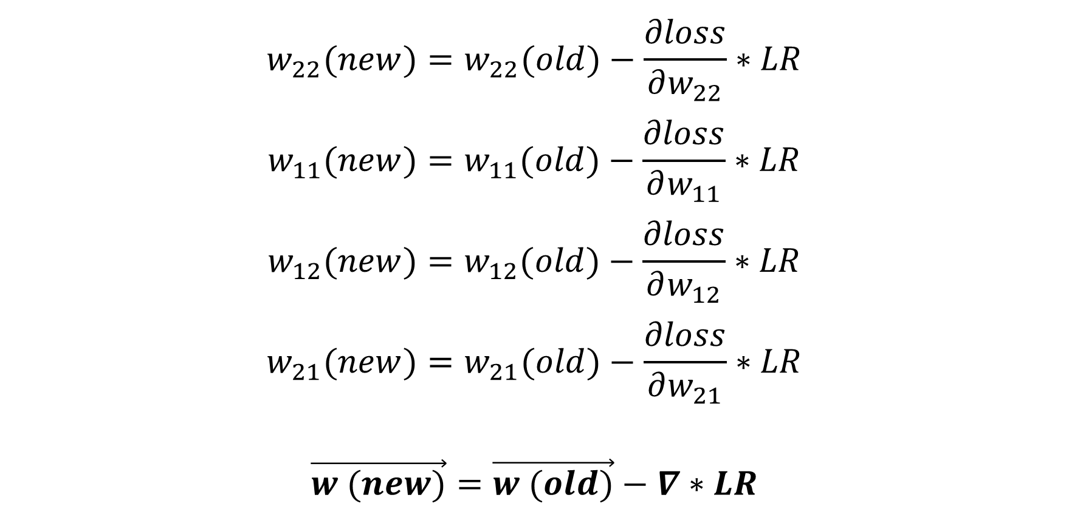
$$w_{22}(new)=w_{22}(old)−\frac{∂loss}{∂w_{22}}∗LR$$
$$w_{11}(new)=w_{11}(old)−\frac{∂loss}{∂w_{11}}∗LR$$
$$w_{12}(new)=w_{12}(old)−\frac{∂loss}{∂w_{12}}∗LR$$
$$w_{21}(new)=w_{21}(old)−\frac{∂loss}{∂w_{21}}∗LR$$
$$\vec{w (new)}=\vec{w (old)}−∇∗LR$$

Slide 10
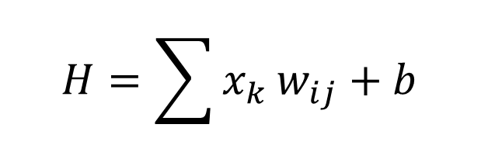
H₁
H
W₂₁
W₁₁
For each neuron H:
x₁
H₂
W₂₂
W₁₂
$$H=\sum{x_{k}}w_{ij}+b$$
y₁
x₂
y₂
w_{ij} is the weight
b is the bias
A DNN has millions of weights and biases
W_{ij}
H_{k}

Slide 11
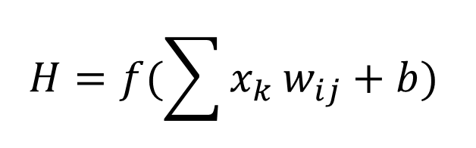
H₁
H
W₂₁
W₁₁
For each neuron H:
x₁
H₂
W₂₂
W₁₂
$$H=f(\sum{x_{k}}w_{ij}+b)$$
y₁
x₂
y₂
f is the activation function
w_{ij} is the weight
b is the bias
A DNN has millions of weights and biases
W_{ij}
H_{k}

Slide 12
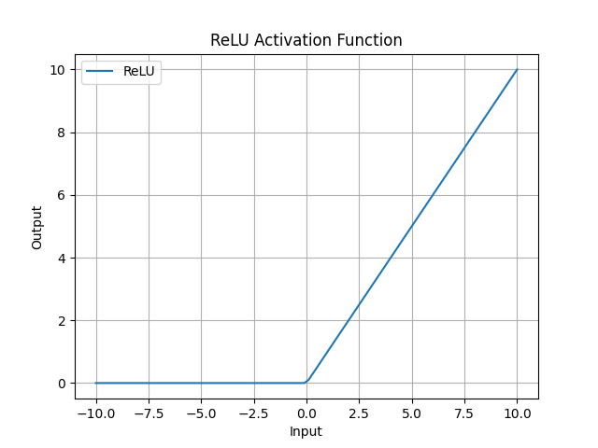

Slide 13
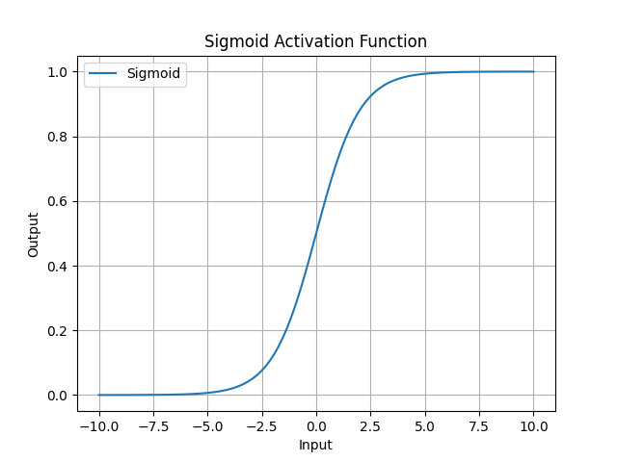

Slide 14
Output types
Regression
Classification
Feature extraction
Combination

Slide 15
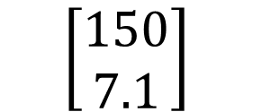
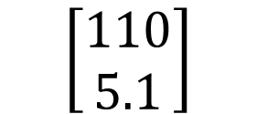
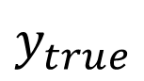
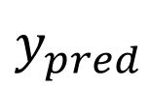
H₁
H
W₂₁
W₁₁
x₁
H₂
W₂₂
W₁₂
y₁
Weight (lbs)
$y_{pred}$
$y_{true}$
x₂
$$\left[\begin{aligned}110 \\ 5.1\end{aligned}\right]$$
$$\left[\begin{aligned}150 \\ 7.1\end{aligned}\right]$$
y₂
Height (feet)
W_{ij}
H_{k}

Slide 16
Regression loss
Mean absolute error
Mean square error
$$MAE=\frac{1}{n}|y_{pred}−y_{true}|$$
$$MSE=\frac{1}{n}{\left(y_{pred}−y_{true}\right)}^{2}$$

Slide 17
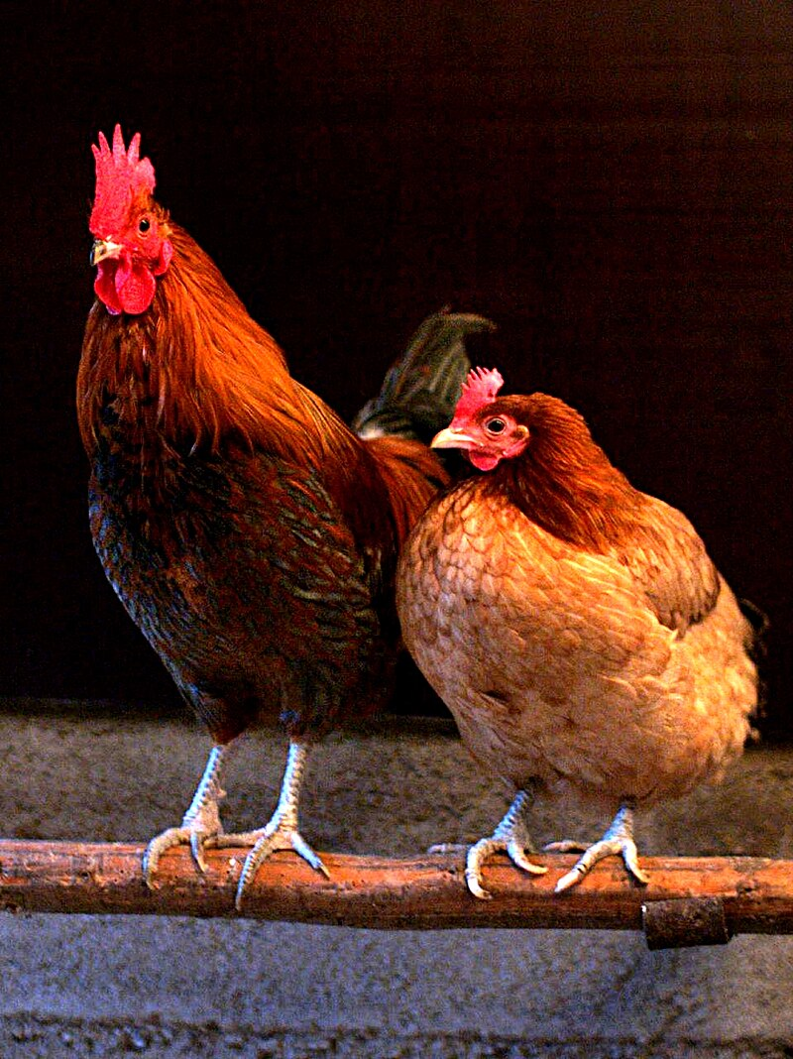
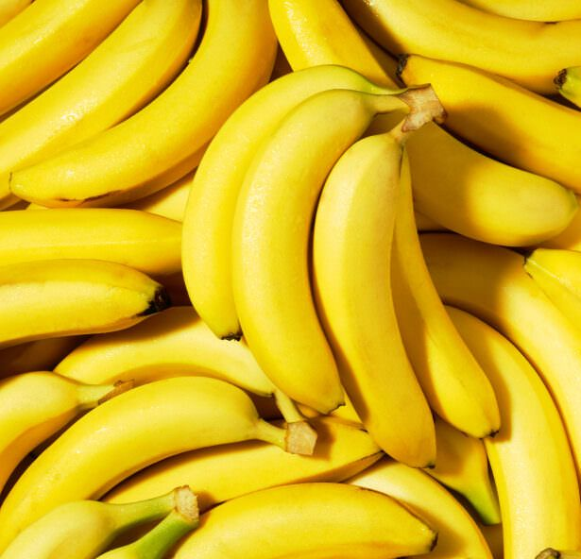
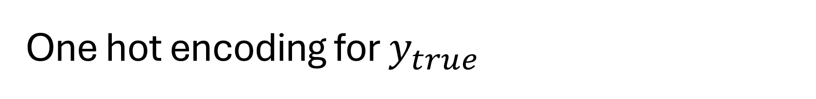
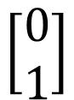
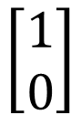
One hot encoding for $y_{true}$
$$\left[\begin{aligned}1 \\ 0\end{aligned}\right]$$
Chicken
Banana
$$\left[\begin{aligned}0 \\ 1\end{aligned}\right]$$

Slide 18

Softmax for y_pred

Slide 19
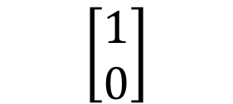
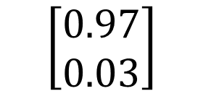
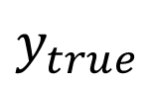
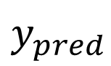
H₁
H
W₂₁
W₁₁
x₁
H₂
W₂₂
W₁₂
y₁
$y_{pred}$
$y_{true}$
Chicken
x₂
$$\left[\begin{aligned}0.97 \\ 0.03\end{aligned}\right]$$
$$\left[\begin{aligned}1 \\ 0\end{aligned}\right]$$
y₂
Banana
W_{ij}
H_{k}

Slide 20
Cross entropy loss for classification
Binary cross entropy
After softmax
Multi class entropy
After softmax
$$BCE=−\sum{y_{true}∗\log\left(y_{pred}\right)+\left(1−y_{true}\right)∗log⁡(1−y_{pred})}$$
$$CE=−\sum{y_{true}∗\log\left(y_{pred}\right)}$$

Slide 21
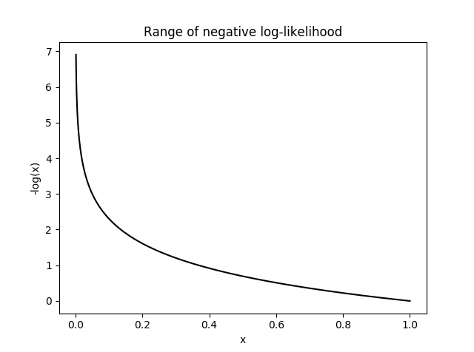

Slide 22
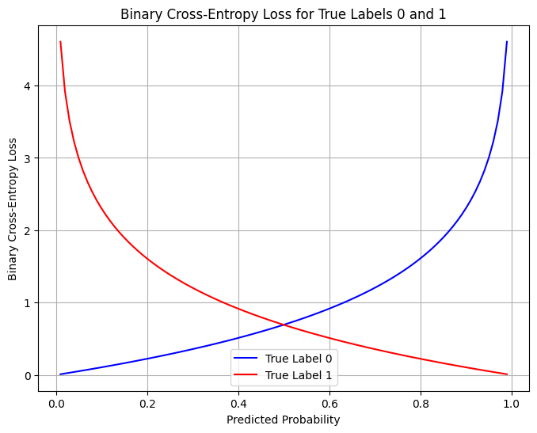

Slide 23

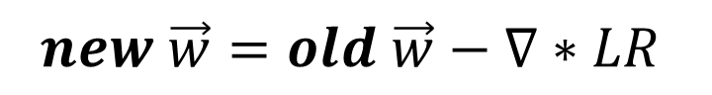
Weight update
H₁
H
W₂₁
W₁₁
x₁
H₂
W₂₂
W₁₂
Learn
Fit
Train
Back propagation
y_{1_true}
y₁
x₂
$$loss$$
y₂
y_{2_true}
W_{ij}
H_{k}
$$new \vec{w}=old \vec{w}−∇∗LR$$

Slide 24

Use the model
H₁
H
W₂₁
W₁₁
x₁
H₂
W₂₂
W₁₂
Forward pass
Inference
Test
Validation
Deployment
y₁
x₂
y₂
W_{ij}
H_{k}
$$NN\left(\vec{x}\right)=\vec{y}$$

Slide 25
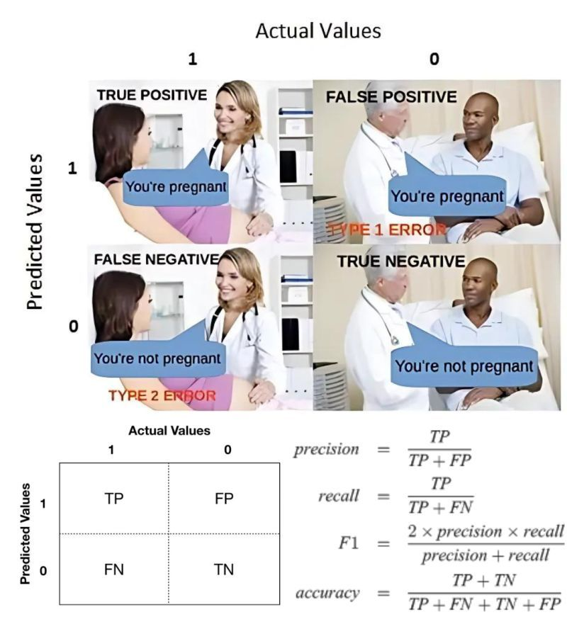
Image Credit: Linkedin.com

Slide 26
Underfitting
Overfitting
Loss
Validation
Training
0
Epoch

Slide 27
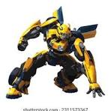
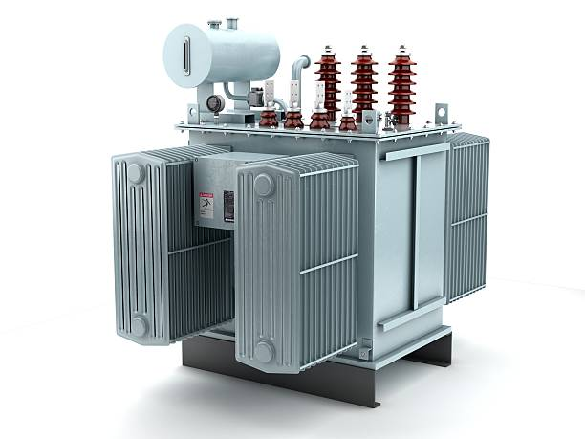
Natural language processing
Chat-GPT: Chat Generative Pre-trained Transformer
Generative AI
Pre-trained weights
Chat: large language model

Slide 28
Auto encoder decoder
H₁
H
H₁
H
W₂₁
W₂₁
W₁₁
W₁₁
x₁
H₂
W₂₂
x₁
H₂
W₂₂
W₁₂
W₁₂
x₂
…
x₂
W_{ij}
W_{ij}
H_{k}
H_{k}

Slide 29
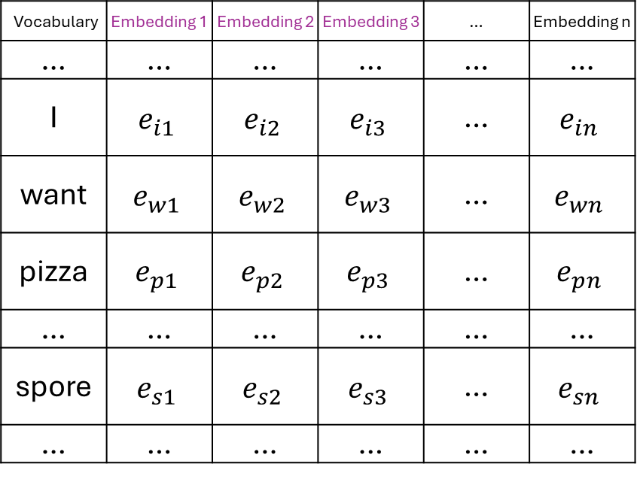
… | I | want | pizza | … | spore | …
Total Text Corpus
Vocabulary | Embedding 1 | Embedding 2 | Embedding 3 | … | Embedding n
… | … | … | … | … | …
I | $$e_{i1}$$ | $$e_{i2}$$ | $$e_{i3}$$ | … | $$e_{in}$$
want | $$e_{w1}$$ | $$e_{w2}$$ | $$e_{w3}$$ | … | $$e_{wn}$$
pizza | $$e_{p1}$$ | $$e_{p2}$$ | $$e_{p3}$$ | … | $$e_{pn}$$
… | … | … | … | … | …
spore | $$e_{s1}$$ | $$e_{s2}$$ | $$e_{s3}$$ | … | $$e_{sn}$$
… | … | … | … | … | …
Embedding 1
I
pizza
want
spore
Embedding 2
Embedding 3

Slide 30
Turning words to numbers
Tokenization: https://tiktokenizer.vercel.app/
Vectorization: https://projector.tensorflow.org/
Does not work with math:
https://grok.com/
https://copilot.microsoft.com
https://chatgpt.com/
67544*090766*0.00987*0.9876

Slide 31
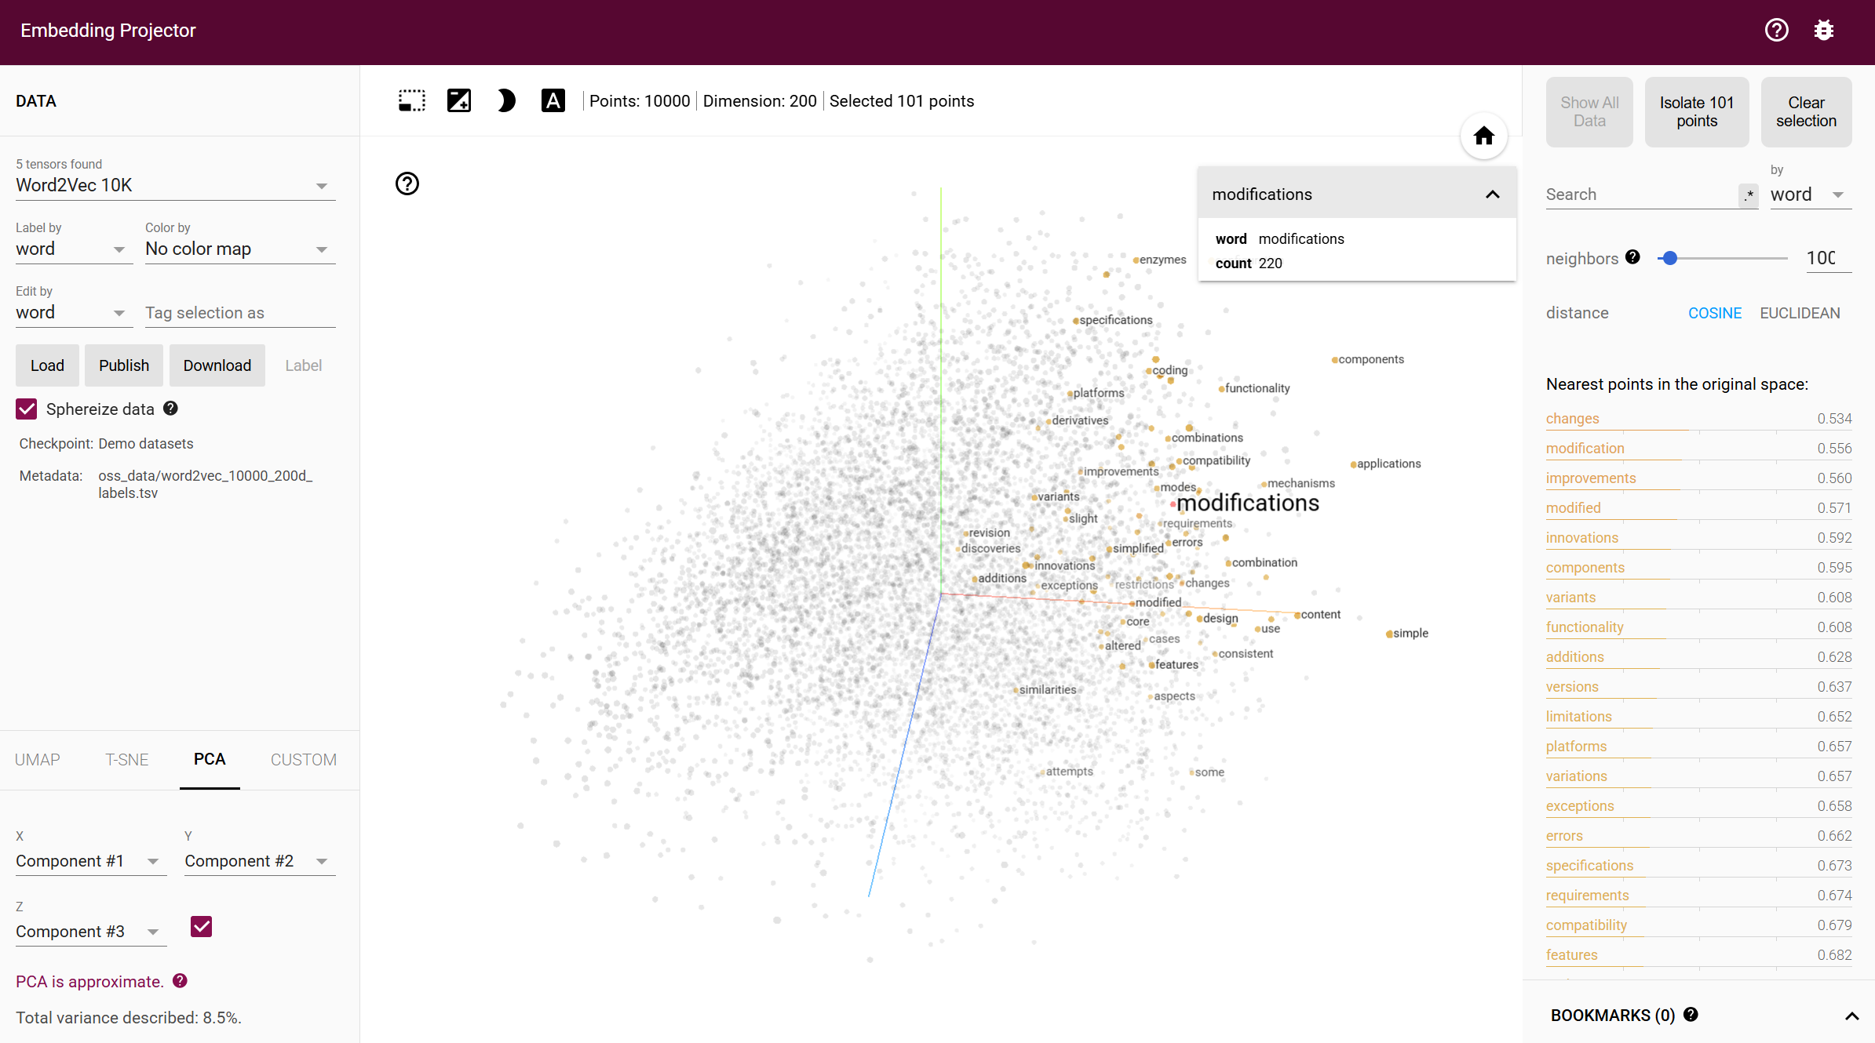

Slide 32
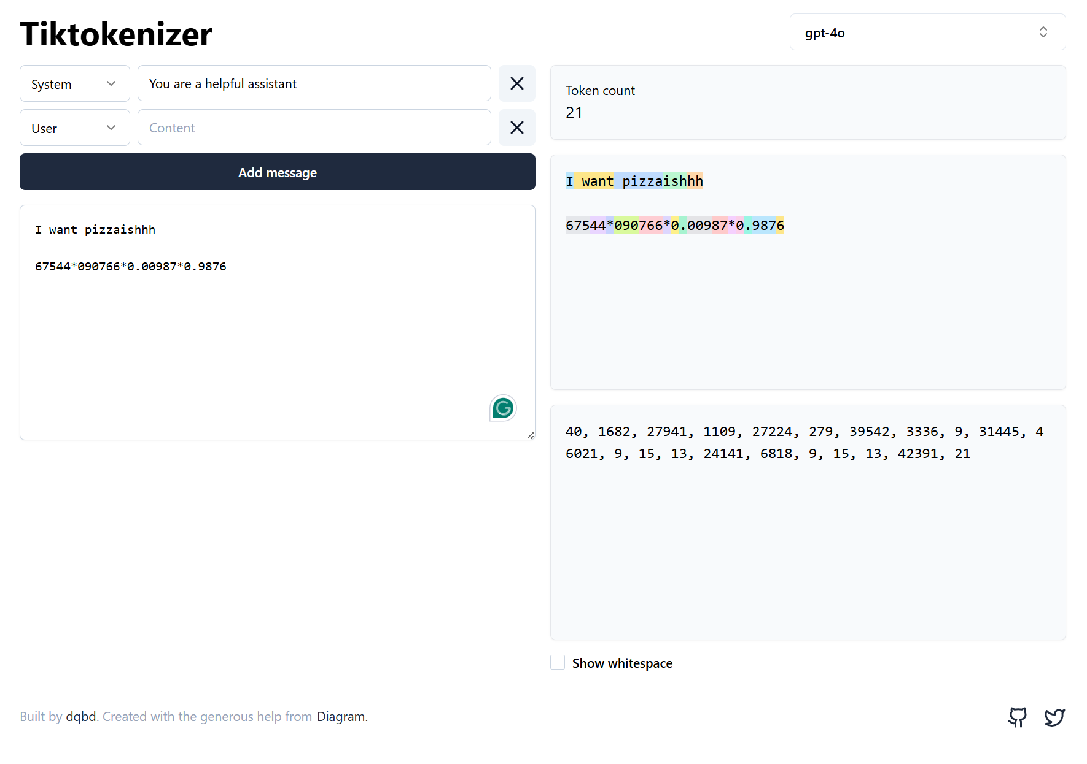

Slide 33
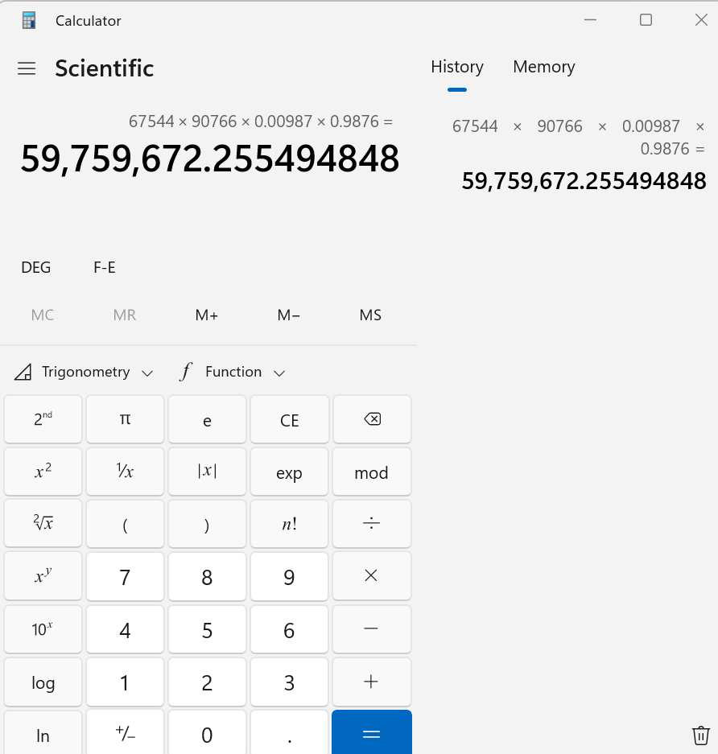

Slide 34
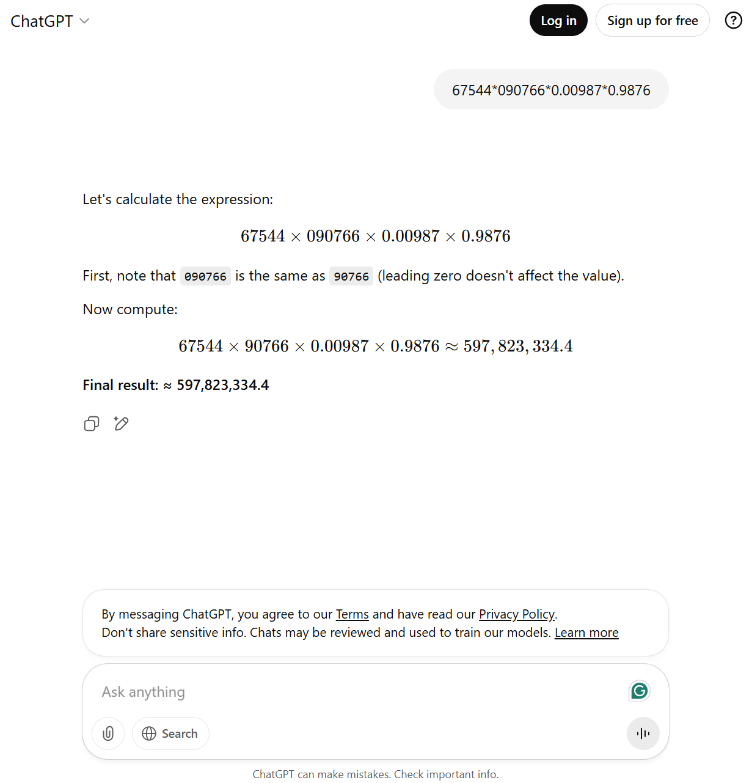

Slide 35
LLM dataset
Common crawl
Math
Code
Translation
Commercial companies are close sourced

Slide 36
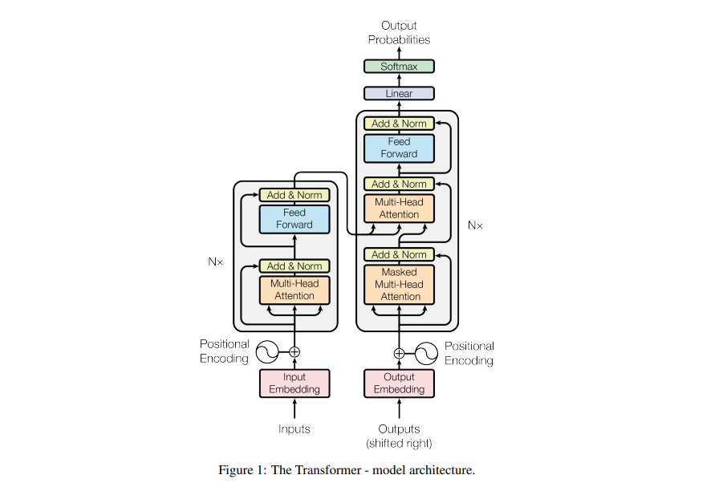
Probability for each word in the vocabulary
Vaswani, A. (2017). Attention is all you need. Advances in Neural Information Processing Systems.

Slide 37
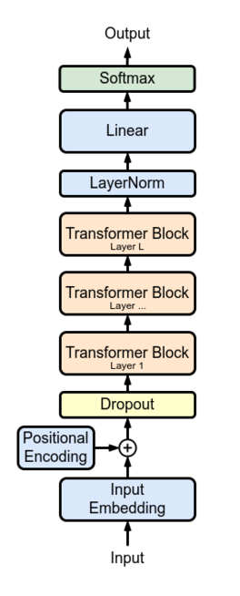
Probability | 0.07 | 0.91 | 0.01 | … | 0.00 | …
Vocabulary | want | from | pizza | … | spore | …
Input window |  |  | Next
I | want | pizza | ____
want | pizza | from | ____
… | … | … | …
Word | Dim 1 | Dim 2 | Dim 3 | Dim 4
I | 0.23 | -0.48 | 0.77 | 0.12
want | -0.61 | 0.35 | -0.10 | 0.56
pizza | 0.44 | 0.89 | -0.33 | -0.21

Slide 38
GPT 3
Parameters 175 B
Dataset 45T
96 attention heads
2048 token size
Learn from their chief scientist: https://www.youtube.com/watch?v=kCc8FmEb1nY

Slide 39
H₁
H
W₂₁
W₁₁
x₁
H₂
W₂₂
W₁₂
y₁
Safe
x₂
y₂
Not safe
W_{ij}
H_{k}

Slide 40
Computer vision

Slide 41
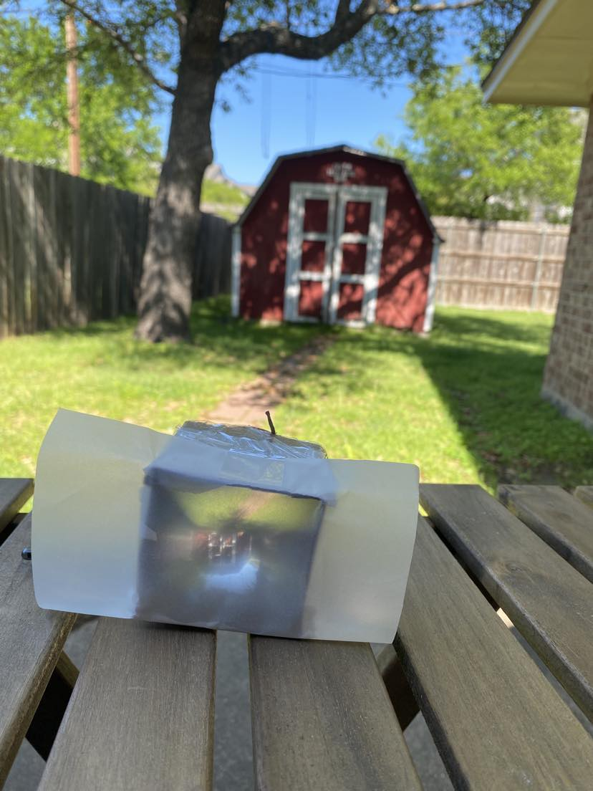
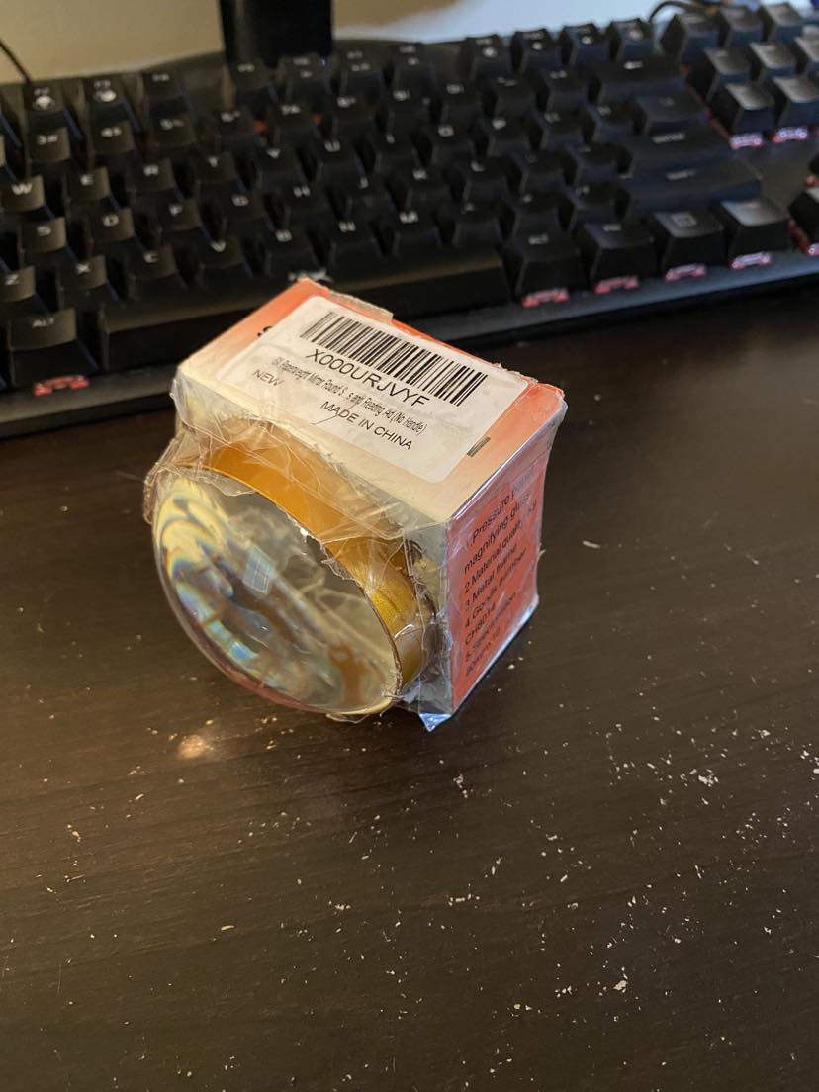

Slide 42
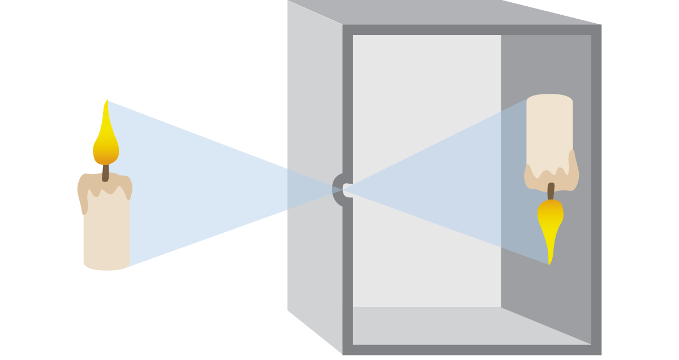
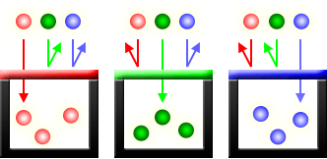
Pinhole principle
Traditional film
Digital sensors (CCD and CMOS)
Red Green Blue (RGB) channels

Slide 43
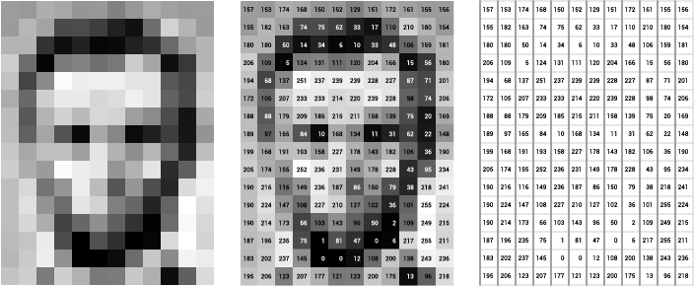
Grey Scale
Image of Abraham Lincoln as a matrix of pixel values. Image Credit: Thomas Smits

Slide 44
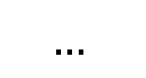
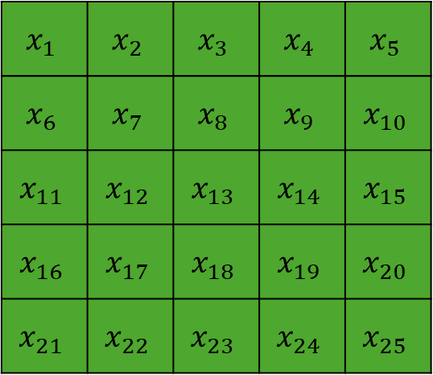
H₁
H
W₂₁
W₁₁
$$x_{1}$$ | $$x_{2}$$ | $$x_{3}$$ | $$x_{4}$$ | $$x_{5}$$
$$x_{6}$$ | $$x_{7}$$ | $$x_{8}$$ | $$x_{9}$$ | $$x_{10}$$
$$x_{11}$$ | $$x_{12}$$ | $$x_{13}$$ | $$x_{14}$$ | $$x_{15}$$
$$x_{16}$$ | $$x_{17}$$ | $$x_{18}$$ | $$x_{19}$$ | $$x_{20}$$
$$x_{21}$$ | $$x_{22}$$ | $$x_{23}$$ | $$x_{24}$$ | $$x_{25}$$
x₁
H₂
W₂₂
W₁₂
y₁
x₂
$$…$$
y₂
W_{ij}
H_{k}

Slide 45
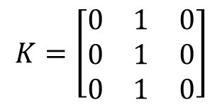
Convolution Computation
7 | 7 | 7 | 7 | 5
7 | 7 | 7 | 5 | 5
7 | 7 | 5 | 5 | 5
7 | 5 | 5 | 5 | 5
5 | 5 | 5 | 5 | 5
7 | 7 | 7 | 7 | 5
7 | 7 | 7 | 5 | 5
7 | 7 | 5 | 5 | 5
7 | 5 | 5 | 5 | 5
5 | 5 | 5 | 5 | 5
7 | 7 | 7 | 7 | 5
7 | 7 | 7 | 5 | 5
7 | 7 | 5 | 5 | 5
7 | 5 | 5 | 5 | 5
5 | 5 | 5 | 5 | 5
$$K=\left[\begin{matrix}0 & 1 & 0 \\ 0 & 1 & 0 \\ 0 & 1 & 0\end{matrix}\right]$$
0 | 0 | 0 | 0 | 0
0 | 21 | 19 | 17 | 0
0 | 19 | 17 | 15 | 0
0 | 17 | 15 | 15 | 0
0 | 0 | 0 | 0 | 0
Kernel at position 1
Kernel at position 2
Kernel at position n

Slide 46
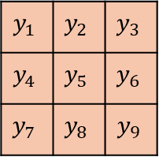
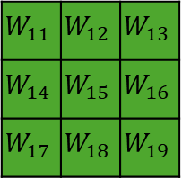
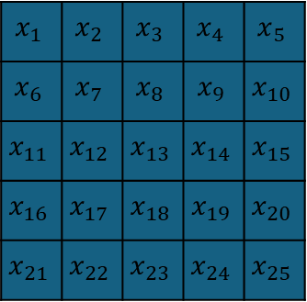
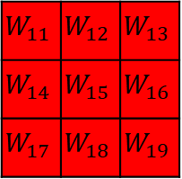






$$x_{1}$$ | $$x_{2}$$ | $$x_{3}$$ | $$x_{4}$$ | $$x_{5}$$
$$x_{6}$$ | $$x_{7}$$ | $$x_{8}$$ | $$x_{9}$$ | $$x_{10}$$
$$x_{11}$$ | $$x_{12}$$ | $$x_{13}$$ | $$x_{14}$$ | $$x_{15}$$
$$x_{16}$$ | $$x_{17}$$ | $$x_{18}$$ | $$x_{19}$$ | $$x_{20}$$
$$x_{21}$$ | $$x_{22}$$ | $$x_{23}$$ | $$x_{24}$$ | $$x_{25}$$
$$x_{1}$$ | $$x_{2}$$ | $$x_{3}$$ | $$x_{4}$$ | $$x_{5}$$
$$x_{6}$$ | $$x_{7}$$ | $$x_{8}$$ | $$x_{9}$$ | $$x_{10}$$
$$x_{11}$$ | $$x_{12}$$ | $$x_{13}$$ | $$x_{14}$$ | $$x_{15}$$
$$x_{16}$$ | $$x_{17}$$ | $$x_{18}$$ | $$x_{19}$$ | $$x_{20}$$
$$x_{21}$$ | $$x_{22}$$ | $$x_{23}$$ | $$x_{24}$$ | $$x_{25}$$
$$x_{1}$$ | $$x_{2}$$ | $$x_{3}$$ | $$x_{4}$$ | $$x_{5}$$
$$x_{6}$$ | $$x_{7}$$ | $$x_{8}$$ | $$x_{9}$$ | $$x_{10}$$
$$x_{11}$$ | $$x_{12}$$ | $$x_{13}$$ | $$x_{14}$$ | $$x_{15}$$
$$x_{16}$$ | $$x_{17}$$ | $$x_{18}$$ | $$x_{19}$$ | $$x_{20}$$
$$x_{21}$$ | $$x_{22}$$ | $$x_{23}$$ | $$x_{24}$$ | $$x_{25}$$
$$y_{1}$$ | $$y_{2}$$ | $$y_{3}$$
$$y_{4}$$ | $$y_{5}$$ | $$y_{6}$$
$$y_{7}$$ | $$y_{8}$$ | $$y_{9}$$
Input matrix: 5x5x3
(red)$y_{1}$
$$W_{11}$$ | $$W_{12}$$ | $$W_{13}$$
$$W_{14}$$ | $$W_{15}$$ | $$W_{16}$$
$$W_{17}$$ | $$W_{18}$$ | $$W_{19}$$
$$W_{11}$$ | $$W_{12}$$ | $$W_{13}$$
$$W_{14}$$ | $$W_{15}$$ | $$W_{16}$$
$$W_{17}$$ | $$W_{18}$$ | $$W_{19}$$
$$W_{11}$$ | $$W_{12}$$ | $$W_{13}$$
$$W_{14}$$ | $$W_{15}$$ | $$W_{16}$$
$$W_{17}$$ | $$W_{18}$$ | $$W_{19}$$
(green)$y_{1}$
Output size: 3x3x2
(blue)$y_{1}$
Kernel size: 3x3x3

Slide 47




Convolutional Nueral Network
$$y_{1},y_{2},…y_{n}$$
…
…
RGB Input
(128x128x3)
50 filters
(3x3x3)
Tensor
(128x128x50)
$k$ filters
(3x3x50)
Output
(1000 classes)
…

Slide 48

Large dataset
COCO: https://cocodataset.org/#home (80 classes)
ImageNet (1000 classes with 1.3M labeled images)
Common Crawl (~100TB+)

Slide 49


Transfer learning
$$y_{1},y_{2},…y_{80}$$
…
…
…
Input
Convolution layer
Output (80)

Slide 50

Transfer learning
$$y_{1},y_{2},…y_{6}$$
…
…
…
Input
Convolution layer
Output (6)

